Slide 1
PETRONAS Technology Challenge 6
Parrot GSDK Training
open

Slide 2
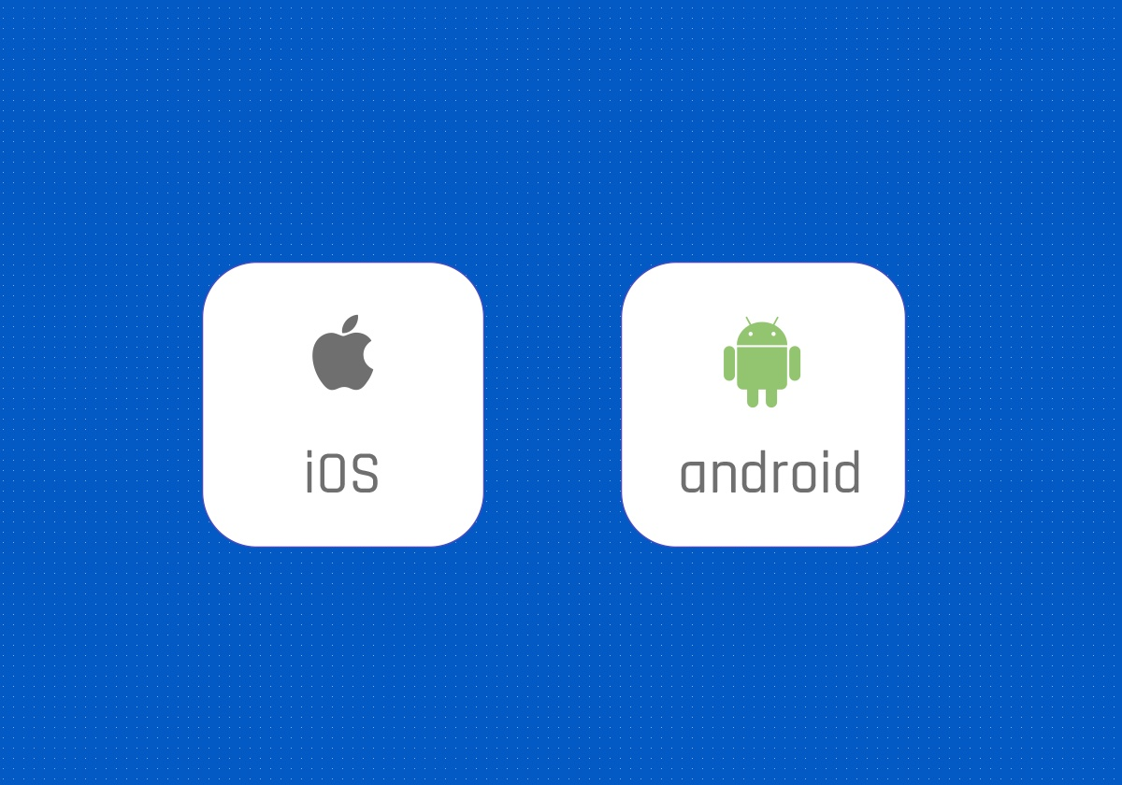
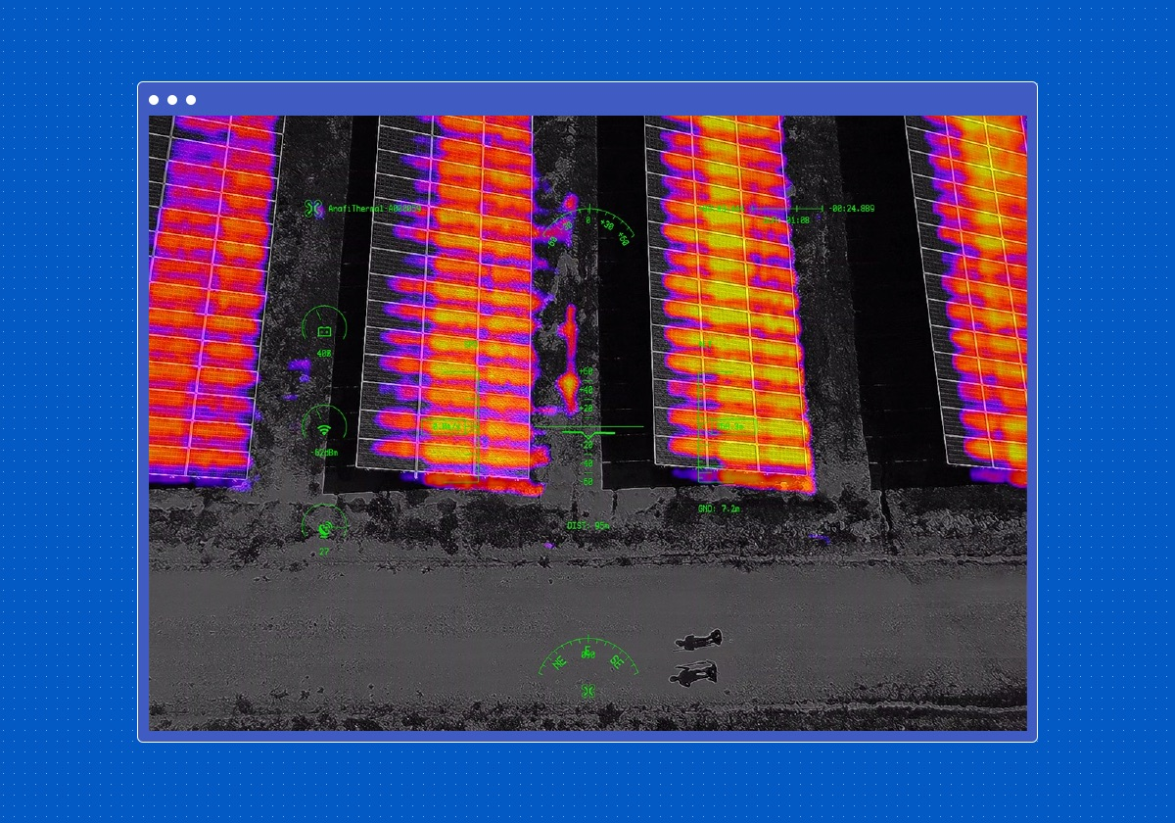
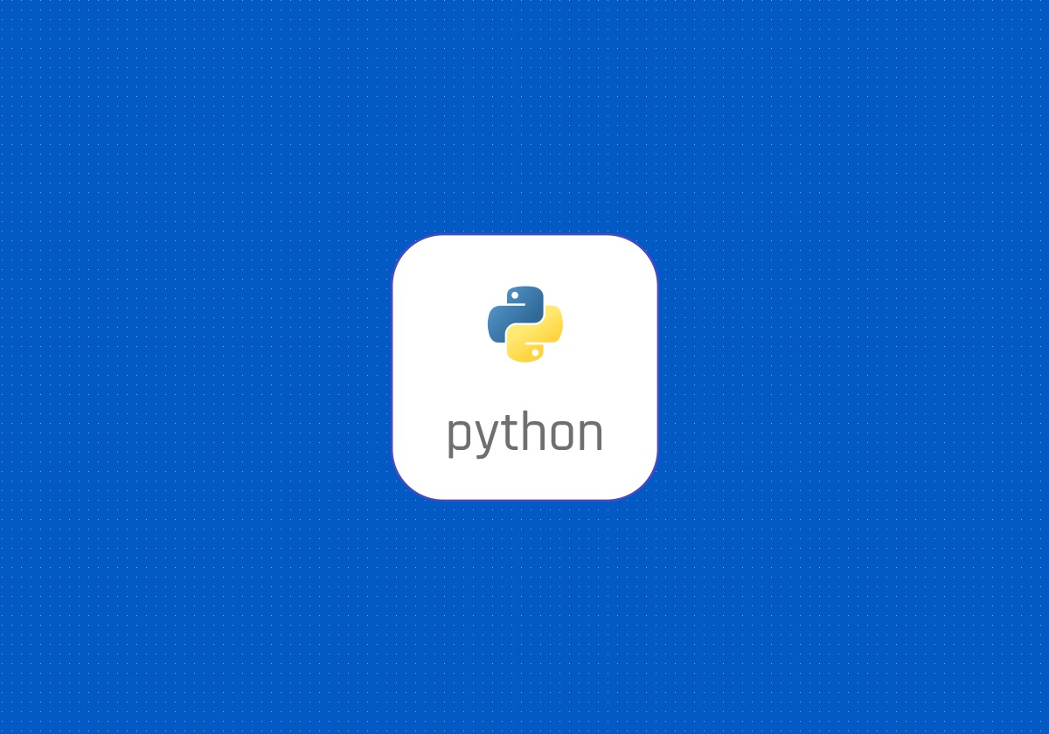
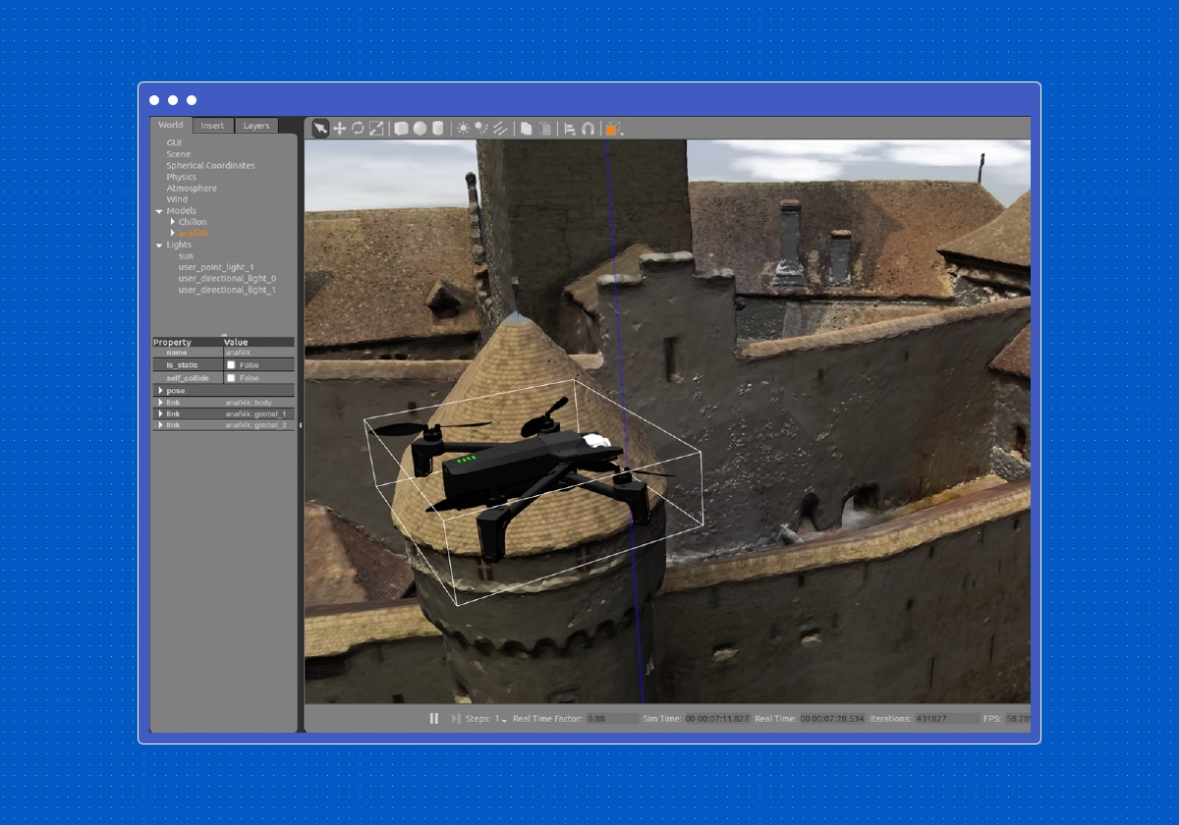
Parrot Ground SDK Overview
Ground SDK Mobile
PDrAW
OLYMPE
SPHINX drone simulator
video viewer and pipeline
Python framework for drone and simulation
Notes:
Olympe also provides video streaming through PDrAW.
Olympe uses ARSDK messages to control a drone.
Source: All images and information are from Parrot developer website
Notes:
Ground SDK Mobile allows any developer to create its own application for ANAFI. All the features of the ANAFI (control, video, settings) are accessible through an easy-to-use and fully documented API set.
Olympe provides a Python controller programming interface for Parrot Drone.
Parrot Sphinx is a simulation environment for Parrot Drones, based on the Gazebo engine.

Slide 3
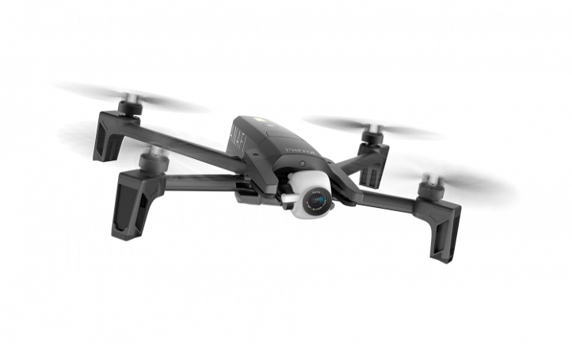
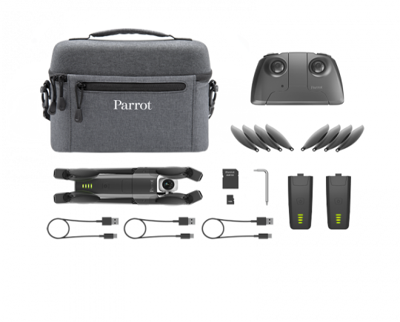

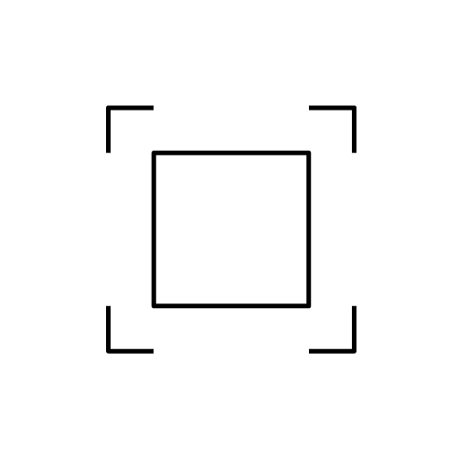
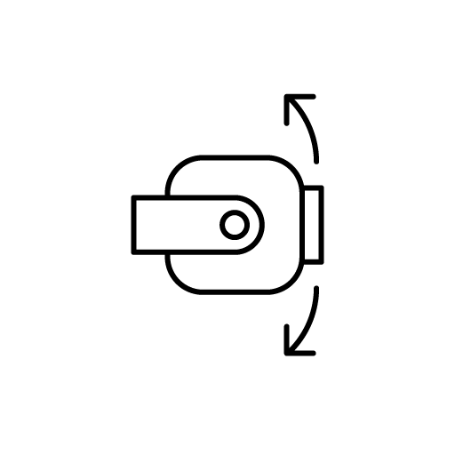


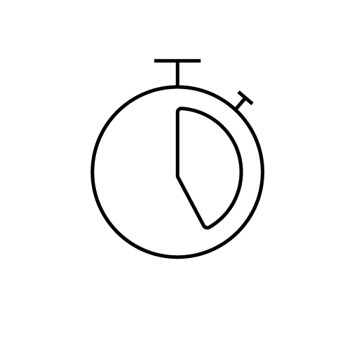

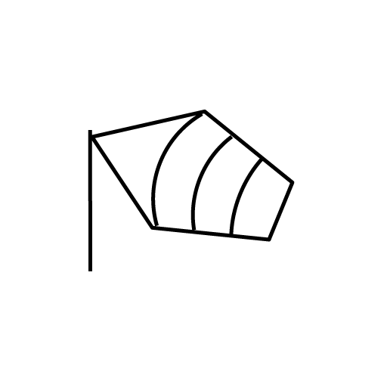
Parrot Anafi Extended
Size unfolded: 175x240x65mm
Weight: 320g
Max transmission range: 4km with controller
What is on the Pack:
4K 21MP camera
2.8X lossless zoom
180° tilt gimbal
3 Axis Image Stabilization
Smart Return to Home & geofence
25 min
Flight time
USB-C charging
50 km/h
wind resistance
Source: All images and information are from Parrot official website
Notes:
What is on the Pack:
1 Parrot Anafi Drone
2 additional Smart Battery
1 Parrot Skycontroller 3
1 compact travel bag
16 GB Micro-SD card + SD adpter
3 USB-A to USB-C cable
8 additional ultra-quiet propeller blades
1 Mounting tool

Slide 4
Software Setup:
System Requirements:
Ubuntu 18.04 (bionic)
PC must support OpenGL in version 3.0 or higher. (for Sphinx)
Install Sphinx:
Follow instructions here: https://developer.parrot.com/docs/sphinx/installation.html
Install Olympe:
Follow instructions here: https://developer.parrot.com/docs/sphinx/installation.html
Install pdraw (optional):
Follow instructions here: https://developer.parrot.com/docs/pdraw/installation.html
Notes:
For Sphinx, check system requirements here: https://developer.parrot.com/docs/sphinx/system-requirements.html

Slide 5
Sphinx
To Start a Simulated Anafi:
Start Firmwared:
sudo systemctl start firmwared.service
Check your wifi interface name using iwconfig
Launch simulation with stolen interface:
$ sphinx /opt/parrot-sphinx/usr/share/sphinx/drones/anafi4k.drone::stolen_interface=<your_interface_name>:eth0:192.168.42.1/24
Or launch simulation without stolen interface:
sphinx /opt/parrot-sphinx/usr/share/sphinx/drones/anafi4k.drone::stolen_interface=
To connect your simulated drone to controller or phone follow instructions here: https://developer.parrot.com/docs/sphinx/connectdrone.html
Use CTRL+R to reset simulation.
Notes:
For the first time Parrot-Sphinx is started with .drone file, it may take several seconds to download the drone firmware from the external server.
* You can disable the GPS through the web interface of the simulator as follows:
When the simulator is running, open its web interface at http://localhost:9002/ in your browser.
Drag and drop an “Inspector” widget in the content area.
In the newly created “Inspector” widget browse to the “root/anafi4k/gps/gps/out_of_order” parameter and set it to “true”.

Slide 6
Olympe Python Environment
To activate Python environment (has to be done in each terminal):
from workspace:
source ./products/olympe/linux/env/shell
from outside:
source ~/code/parrot-groundsdk/./products/olympe/linux/env/shell
To run any python script:
python script_name.py
To control a simulated drone, you need to ensure the drone is already spawned in Sphinx.
Use pip to install additional python packages. If you get permission denied issue, change the permission of the whole SDK folder to permit read/write/execute.
Notes:
https://developer.parrot.com/docs/olympe/userguide.html
To change permission use sudo chmod -R a+rwx /path/to/folder” to give permissions to a folder and every file and folder inside it.

Slide 7
Olympe Basics
Drone Connection
First step in Olympe is to connect to the Drone using its IP address. Default IP for simulated drone is 10.202.0.1 while default for actual drone is 192.168.42.1.
import olympe # import olympe package
drone = olympe.Drone("10.202.0.1") # create Drone instance
drone.connection() # connect to the drone.
….
# at the end of the script, we should disconnect from the drone.
drone.disconnection()
Drone TakeOff/Land
Takeoff and Land commands are available in olympe.messages.ardrone3.Piloting package. We can takeoff/land as follows:
from olympe.messages.ardrone3.Piloting import TakeOff, Landing
drone(TakeOff()).wait() # wait makes the call blocking until a response is received.
…..
drone(Landing()).wait()
Practice 1
Notes:
https://developer.parrot.com/docs/olympe/userguide.html
Many commands return an event to indicate the command was sent successfully or not such as
response = drone(TakeOff).wait()
if response.success():
print(“Successful takeoff command”)
If you don’t want to see the drone events, you can direct the log into a file
file_object = open('log_drone.txt', 'w', encoding='UTF-8’)
drone = olympe.Drone("10.202.0.1", logfile=file_object)

Slide 8
Olympe Basics
Expectations:
A command message travel from the controller (Olympe) to the drone while an event message travel the other way around.
Most command messages implicitly expect an event message in return.
For example:
drone(
TakeOff()
>> FlyingStateChanged(state="hovering", _timeout=5)
).wait()
The above code tells Olympe to:
Send the TakeOff() command
Then, implicitly wait for the expectations of the TakeOff() command: FlyingStateChanged(state='takingoff')
Then, explicitly wait for the drone hovering flying state event: FlyingStateChanged(state='hovering')
Here, the drone() functor accepts more than just a command message. The drone() takes an expression that may be a combination of command and event messages to process. The “>>” operator is used to combine two expressions with an “and then” semantic. This example could be read as “Take off and then wait a maximum of 5 seconds for the “hovering” flying state”).
Notes:
https://developer.parrot.com/docs/olympe/userguide.html

Slide 9
Olympe Basics
Drone Relative Movements
You can move the drone relative to its current position using the command moveBy.
The command has the following signature: moveBy(dX, dY, dZ, dPsi). dX,dY and dZ are displacements in meter. dPsi is heading in radian.
An example to move by 0.5 meter in x-direction:
from olympe.messages.ardrone3.Piloting import moveBy
from olympe.messages.ardrone3.PilotingState import FlyingStateChanged
drone(
moveBy(0.5, 0, 0, 0)
>> FlyingStateChanged(state="hovering", _timeout=5)
).wait()
Notes:
We use FlyingStateChanged to wait for drone to hover after moveBy command ends.
The “>>” operator is used to combine two expressions with an “and then” semantic. MoveBy x:0.5 then wait until flyingState changes to hovering.
Use left-hand rule to decide x/y/z axis. Heading positive value results in clockwise rotation.
Practice 2
Notes:
https://developer.parrot.com/docs/olympe/userguide.html
There is currently a firmware bug that holds the drone state in ‘flying’ even after moveByEnd event has been issued.

Slide 10
Olympe Basics
Drone State:
You can get any current drone-related state using Drone.get_state method. You have to specify the event message as parameter. For comparisons you can use enumuerstions in olympe.enums.
For example:
from olympe.messages.ardrone3.PilotingState import FlyingStateChanged
from olympe.enums.ardrone3.PilotingState import FlyingStateChanged_State
# check current FlyingState(hovering, takingoff, landing, flying, ..)
cur_fly_state = drone.get_state(FlyingStateChanged)['state']
print("current flying state is: ",cur_fly_state)
If cur_fly_state ==FlyingStateChanged_State.hovering: # check if current state is hovering
print("Currently hovering")
# check battery percentage
from olympe.messages.ardrone3.common.CommonState import BatteryStateChanged
print("current battery percentage: ", drone.get_state(BatteryStateChanged)['percent'])
You can explore ardrone3.PilotingState, ardrone3.PilotingSettingsState, common.CommonState packages for the common states.
Drone updates states to Olympe based on a change (not periodically), some states are updated more frequently because they change rapidly.
Practice 3
Notes:
Drone.get_state returns a dictionary whose keys are dependent on the event message requested.
FlyingStateChanged contains a key ‘state’
BatteryStateChanged contains a key ‘percent’
Each event message has a _policy that can be modified. For example _policy="check_wait" means check the latest state if available, else request the state from the drone and wait for reply

Slide 11
Olympe Basics
Piloting:
There are several ways to pilot the drone as follows:
1- Relative Movement using moveBy.
The command signature is moveBy(dX, dY, dZ, dPsi)
If you send a second relative move command, the drone will trigger a moveByEnd() and start the new moveBy command.
2- Roll/Pitch/Yaw angles:
The command signature is piloting_pcmd(roll, pitch, yaw, gaz, piloting_time)
The command is sent each 50ms.
3- GPS waypoint.
The command signature is moveTo(latitude, longitude, altitude, orientation_mode, heading)
Only applicable outdoor with GPS fix.
Practice 4
Notes:
https://developer.parrot.com/docs/olympe/arsdkng_ardrone3_piloting.html

Slide 12
Olympe Basics
Video Streaming:
Olympe provides a method to get video from the drone front camera. First you need to set callbacks for streaming then call start_video_streaming function to start receiving video to python.
drone.set_streaming_callbacks(h264_data_cb,h264_meta_cb,raw_data_cb,raw_meta_cb)
drone.start_video_streaming()
There are four callbacks you can set:
H264 encoded video
H264 meat data
Raw video
Raw video meta data
There is also a method to save streaming video into a file called drone.set_streaming_output_files.
Currently the video streaming API is broken and Parrot team is trying to patch fixes and provide examples soon.
Notes:
https://developer.parrot.com/docs/olympe/arsdkng_ardrone3_piloting.html

Slide 13
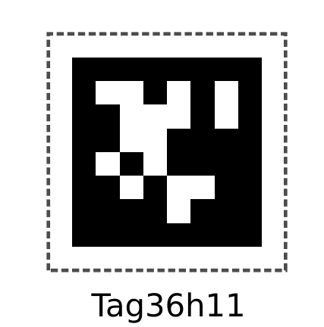
AprilTag
A type of two-dimensional bar code, Similar to QR Codes.
Developed at APRIL Robotics Laboratory at the University of Michigan.
Designed for high localization accuracy— you can compute the precise 3D position of the AprilTag with respect to the camera.
Has C implementation with no external dependencies, and there are wrappers for Python and ROS.
import apriltag
import cv2
detector = apriltag.Detector() # create detector instance
cap = cv2.VideoCapture(0) # open camera to get video frames
while True:
success, frame = cap.read() # get a video frame
if not success: # if no frame, exit
break
gray = cv2.cvtColor(frame, cv2.COLOR_RGB2GRAY) # convert to grayscale
detections, dimg = detector.detect(gray, return_image=True) # detect apriltags in the frame
for detection in detections:
print(detection.tostring()
Practice 6-7
Notes:
https://april.eecs.umich.edu/software/apriltag
Python wrapper: https://github.com/swatbotics/apriltag

Slide 14
Thank You Q&A

